Slide 1
IDEA
International Data Encryption Algorithm (IDEA)
PT: 64 bits CT: 64 bits Key: 128 bits
Word (block) size:16 bits
No of rounds: 8
Operations: XOR, +mod2^16, *mod2^16 +1
Divide PT into 4 equal parts of 16 bits
Divide Key into 8 equal parts of 16 bits. Apply left circular shift by 25 bits and divide key … continue this process to generate all subkeys.

Slide 2
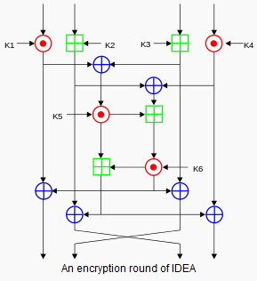

Slide 3
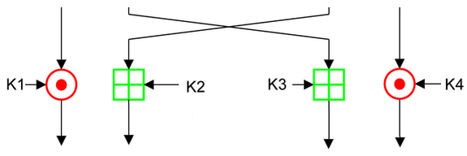
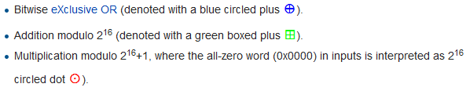
Output transform (9th round)

Slide 4
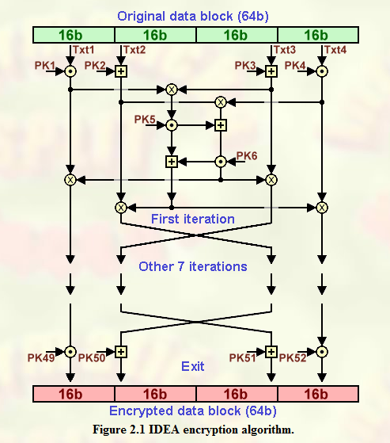

Slide 5
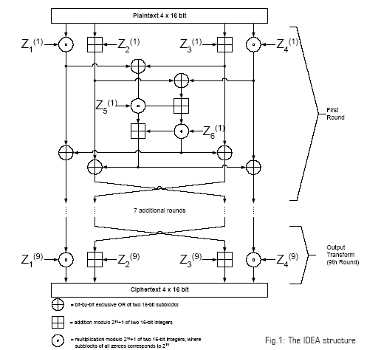

Slide 6
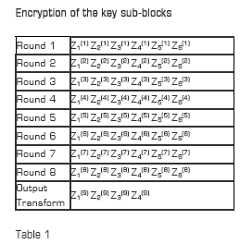

Slide 7
Decryption.
Use encryption algorithm for decryption where subkeys are used in the reverse order with multiplicative / additive inverse of the encryption subkeys.

Slide 8
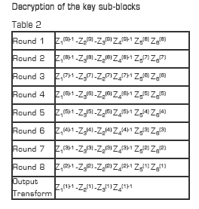

Slide 9
Strength of IDEA
No S-box is used; but non-linearity is provided by +, *
Resistant to several cryptanalytic attacks
No practical weakness
Certain weak keys can be deduced by using chosen plain text attack.

